Slide 1


Weekly Report NTUA 20/5/2020
George Bakas

Slide 2
Status Report
LHCtopWG
TOP-18-013 presentation
Analysis:
Training with Mass Cut (50,300)GeV @ preselection
Larger ttbar contamination vs the previous BDT that has no mass selection criteria
Unfolding Techniques
Giannis found a way to implement the Minimum Global Correlation method using the TUnfoldDensity class
Cross checking results
Error propagation with different methods
Parton and Particle levels
Mass Fit
Cannot understand why the k_{slope} is so big when we implement the fit
Can it be due to statistics??
Simultaneous fit seems to have better results (qcd params are frozen)

Slide 3
New training with mass cut: 50 < m_{top} <300 GeV
With mass cut
Without mass cut

Slide 4
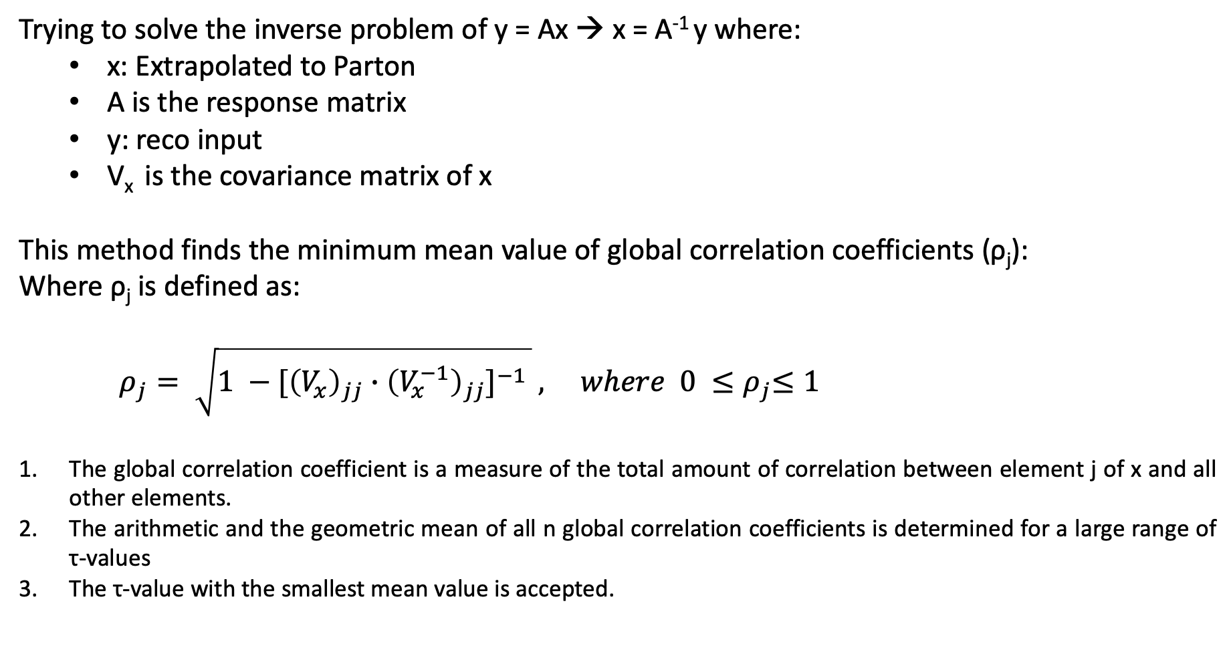
Minimum of global Correlation
Trying to solve the inverse problem of y = Ax → x = A⁻¹ y where:
x: Extrapolated to Parton
A is the response matrix
y: reco input
V_{x} is the covariance matrix of x
This method finds the minimum mean value of global correlation coefficients (ρ_{j}):
Where ρ_{j} is defined as:
$ρ_{j}= \sqrt{1 −{[\left(V_{x}\right)}_{jj} ∙{\left(V_{x}^{−1}\right)}_{jj}]^{−1 }} , where 0 {≤ρ}_{j}≤1$
The global correlation coefficient is a measure of the total amount of correlation between element j of x and all other elements.
The arithmetic and the geometric mean of all n global correlation coefficients is determined for a large range of τ-values
The τ-value with the smallest mean value is accepted.

Slide 5
Unfolding in Particle Level
L-Curve
Global Corr

Slide 6
Unfolding in Particle Level
L-Curve
Global Corr

Slide 7
Unfolding in Particle - Error Propagation

Slide 8
Simultaneous Mass Fit
0-btag
2-btag

Slide 9

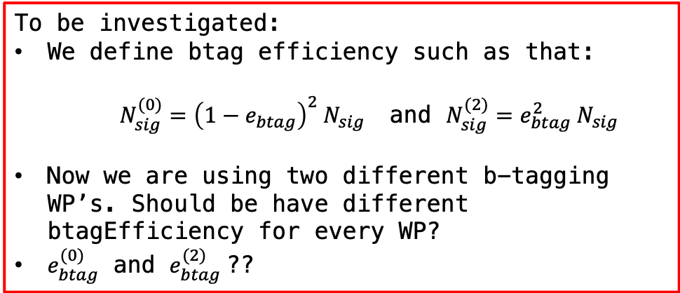
Simultaneous Mass Fit Result
Floating Parameter FinalValue +/- Error
-------------------- --------------------------
btagEff 9.4203e-01 +/- 7.36e-02
kMassResol 9.5275e-01 +/- 2.75e-02
kMassScale 1.0003e+00 +/- 2.02e-03
kQCD_2b 6.8738e-01 +/- 5.82e-01
nFitBkg_0b 7.9304e+01 +/- 1.27e+01
nFitBkg_2b 2.3702e+02 +/- 2.19e+01
nFitQCD_0b 2.0014e+03 +/- 7.22e+01
nFitQCD_2b 2.8167e+03 +/- 1.50e+02
nFitSig 6.1479e+03 +/- 9.94e+02
N0_observed = 20.663, N2_observed = 5455.7
Ntt expected: 7872.02
Ntt observed: 5476.36
Signal strength r: 0.695675
Singal strength r in 2btag: 0.694978
Singal strength r in 0btag: 0.945919
To be investigated:
We define btag efficiency such as that:
$N_{sig}^{(0)}={\left(1−e_{btag}\right)}^{2} N_{sig}$ and $N_{sig}^{(2)}=e_{btag}^{2} N_{sig}$
Now we are using two different b-tagging WP’s. Should be have different btagEfficiency for every WP?
$e_{btag}^{(0)}$ and $e_{btag}^{(2)}$??

